Slide 1


voice assistant
MEMBERS
Divesh Kankani
Gautam Shaw
Shubham Sharma

Slide 2

ABSTRACT
As a Voice Assistant, it assists the end-user with day-to-day activities like general human conversation, searching queries in google, searching for videos, retrieving images, live weather conditions, word meanings and reminding the user about the scheduled events and tasks. The user statements/commands are analysed with the help of machine learning to give an optimal solution.
Bot is a Python-based voice-controlled assistant
It utilizes libraries such as OpenAI, SpeechRecognition, gTTS, pyttsx3, and pywhatkit to enable various functionalities.

Slide 3
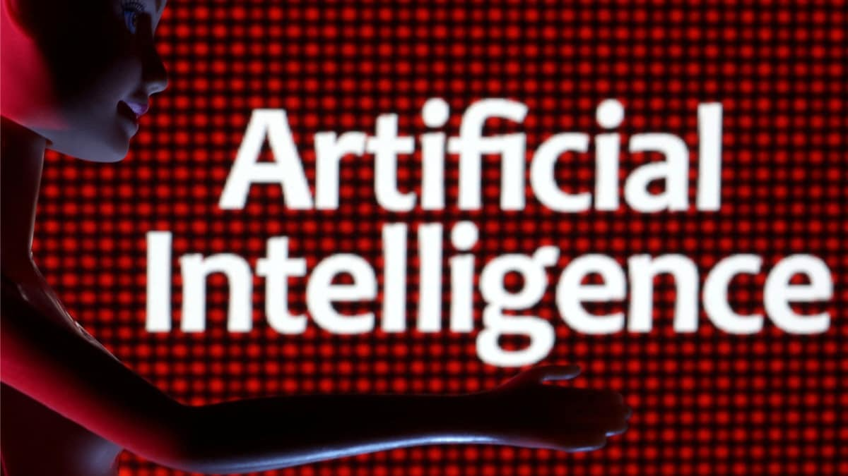
PROBLEM STATEMENT
"The goal of this project is to develop an AI-based Voice Assistant that seamlessly integrates with users' daily routines, providing intelligent, context-aware assistance across various tasks and platforms.
The assistant should be capable of natural language understanding, speech recognition, task automation, and proactive suggestions.
It should adapt and learn from user interactions to enhance its effectiveness over time.
The system should prioritize user privacy and data security while delivering a user-friendly and intuitive interface.
This project aims to create a versatile and personalized AI companion that enhances productivity, efficiency, and convenience for individuals in their professional and personal lives."

Slide 4

OBJECTIVE
The objective of this project is to develop an AI-based Voice Assistant that seamlessly integrates with users' daily routines, providing intelligent, context-aware assistance across various tasks and platforms.
The assistant should be capable of natural language understanding, speech recognition, task automation, and proactive suggestions.
It should adapt and learn from user interactions to enhance its effectiveness over time.
The system should prioritize user privacy and data security while delivering a user-friendly and intuitive interface.
This project aims to create a versatile and personalized AI companion that enhances productivity, efficiency, and convenience for individuals in their professional and personal lives.

Slide 5
LITERATURE REVIEW
NAME OF AUTHOR | PUBLICATION AND YEAR OF PUBLICATION | NAME OF RESEARCH PAPER | OUTCOME
Rajat Sharma , Adweteeya Dwivedi | International Journal of Science and Research (IJSR) Publication year 2020 | "JARVIS" - AI Voice Assistant | Jarvis - An AI Voice Assistant System uses speech recoginition, gTTs and other AI techniques along with Neural Networks and Natural Language Processing for a smart responsive system to the given circumstances or conditions.
F. Alotto I. Scidà A. Osello | EDULEARN20 Proceedings Publication year: 2020 | Building modeling with artificial intelligence and speech recognition | This methodology allows the digital design of a building that is quantifiable, interoperable, modifiable and coherent among the elements that compose it, in every phase of its life cycle.
James P. Giangola et al. | (Cohen et al., 2004;Pearl et al | Voice User Interface Design | This book provides a comprehensive guide to designing effective voice user interfaces, covering topics such as speech recognition, natural language understanding, and user-centered design principles.

Slide 6
CONSTRUCTION WORKING
Live GUI for interaction will appear on the screen
It will take input through voice commands related to the task
It will perform the required task for the user like opening notepad, searching on browser, mails, playing songs etc.
It keeps on asking for the command from user until the user say “Stop”

Slide 7
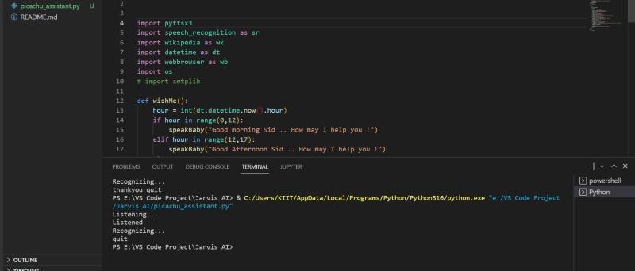
SOFTWARE
The language which is going to be use in this project is Python.
The IDE used in this project is PyCharm. All the python files were created in
PyCharm and all the necessary packages were easily installable in this IDE. For this project following modules and libraries were used i.e. pyttsx3, SpeechRecognition, Datetime, Wikipedia, Smtplib, pywhatkit, pyjokes, pyPDF2, pyautogui, pyQt etc. I have created a live GUI for interacting with the JARVIS as it gives a design and interesting look while having the conversation.

Slide 8
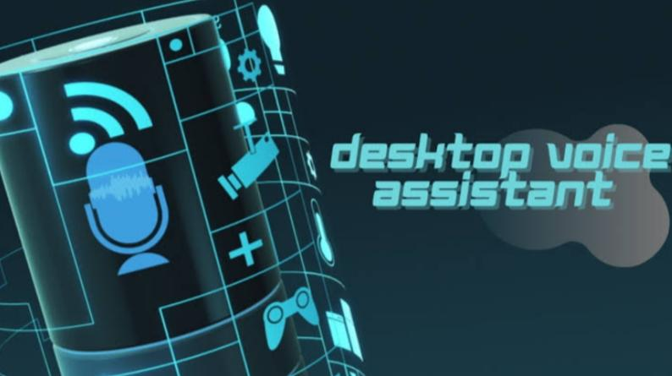
APPLICATION
Saves time: Voice Assistant is a desktop voice assistant which works on the voice command offered to it, it can do voice searching, voice-activated device control and can let us complete a set of tasks.
Conversational interaction: any user when instruct any task to it, they feel like giving task to a human assistant because of the conversational interaction for giving input and getting the desired output in the form of task done.
Reactive nature: The desktop assistant is reactive which means it know human language very well and understand the context that is provided by the user and gives response in the same way.

Slide 9

CONCLUSION
Through this voice assistant, we have automated various services using a single line command. It eases most of the tasks of the user like searching the web, retrieving weather forecast details, vocabulary help and medical related queries. We aim to make this project a complete server assistant and make it smart enough to act as a replacement for a general server administration.

Slide 10
REFERENCE
https://files.gitter.im/COSS-Jarvis/community/nUVs/JARVIS-_-Report-_2_.pdf
https://www.studocu.com/in/document/b-k-birla-college/marketing/jarvis-project-report/19701174

Slide 11
Thank You

